Slide 1
PROTECTION AND INFORMATION FLOW OF PASSENGER BAGGAGE AT AIRPORTS,DOMESTIC AIRPORTS
SUBMITTED BY,
FAHEEN FATHIMA B N
KARTHICK U
GUIDE,
PROF WINSTON PAUL D

Slide 2
abstract
Tracking of bags in an airport can be an issue when the passengers travel using several connecting flights. The retrieval and tracking of bags can be done using EAS system. Appropriate magnetizing and demagnetizing of the sensors are used to transmit a certain frequency at regular intervals .This information is sent to the system surveillance of the airport authority. Java or any other programming can be used to send SMS verification to the passenger once the baggage has reached the destination. In addition to information of position the duration for which the passenger has to wait can be predicted and sent via SMS using the conveyer belt speed and accuracy. The passenger information is erased and the tag is reused for other passengers.

Slide 3
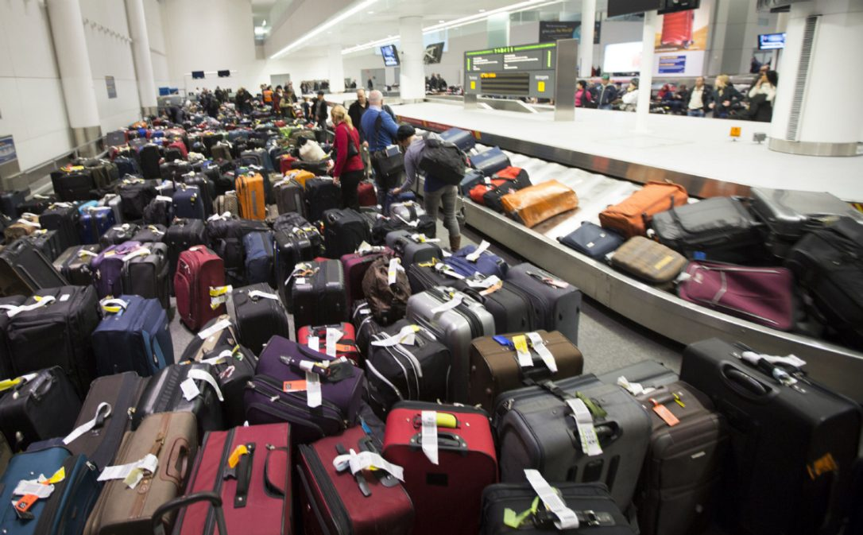
Problem statement
Loss of time
Unavailability of baggage information
Inappropriate assumption of baggage location

Slide 4
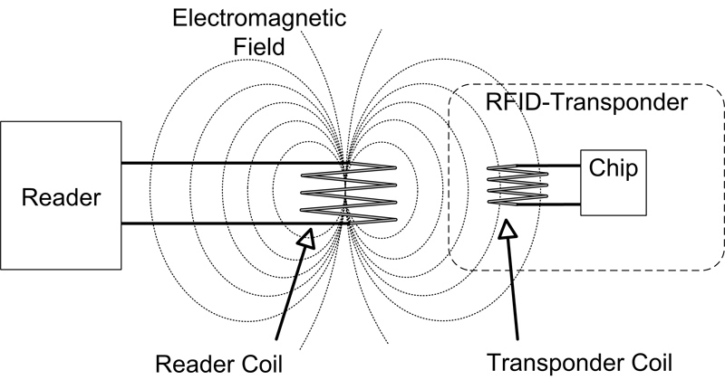
Principles used
ELECTRONOMAGNETISM
RFID
Magnetisation and demagnetisation frequency emitting devices
Radio frequency identification Frequency signals up to 433MHz (13 MHz to cover 1m – 1.5m).

Slide 5
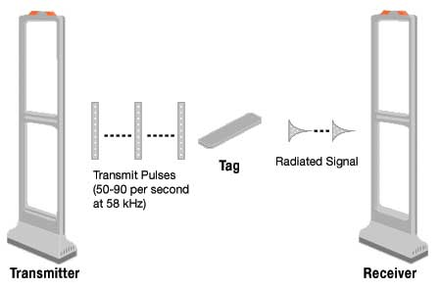
THREE MAIN CONCEPTS
EAS
READING
SIGNALLING
SENSING

Slide 6
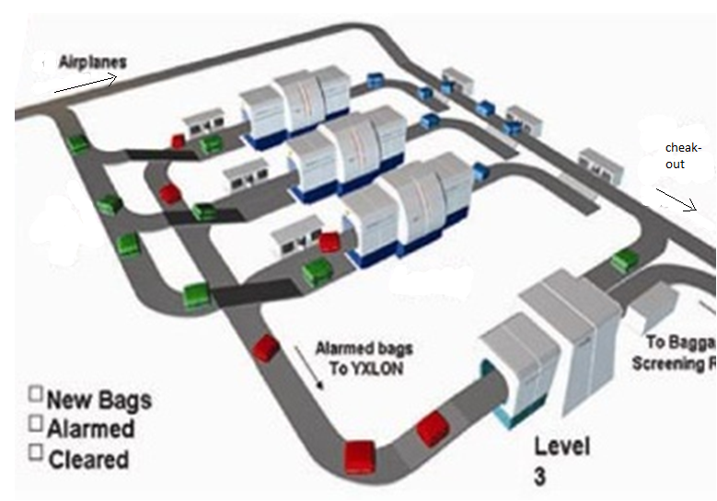
OVERVIEW OF BAGGAGE TRAVEL IN AIRPORT

Slide 7
STEPS INVOLVED IN TRACKING THE BAGGAGE
TAGGING (MAGNETIZATION) at Reception
INFORMATION FLOW at Conveyer belt
RETRIVAL (DEMAGNETIZATION) at Protection vault

Slide 8
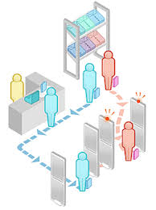
SOLUTIONS
POSITION OF BAGGAGE
SURVEILENCE OF BAGGAGE
TIME CALCULATION
COVEYER BELT FIXED SPEED
COMPARTMENTS

Slide 9
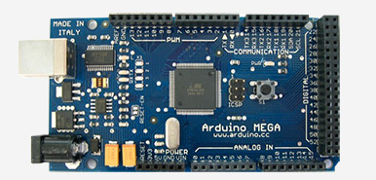
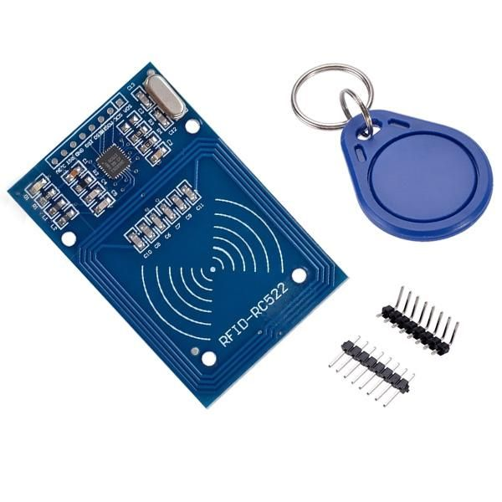
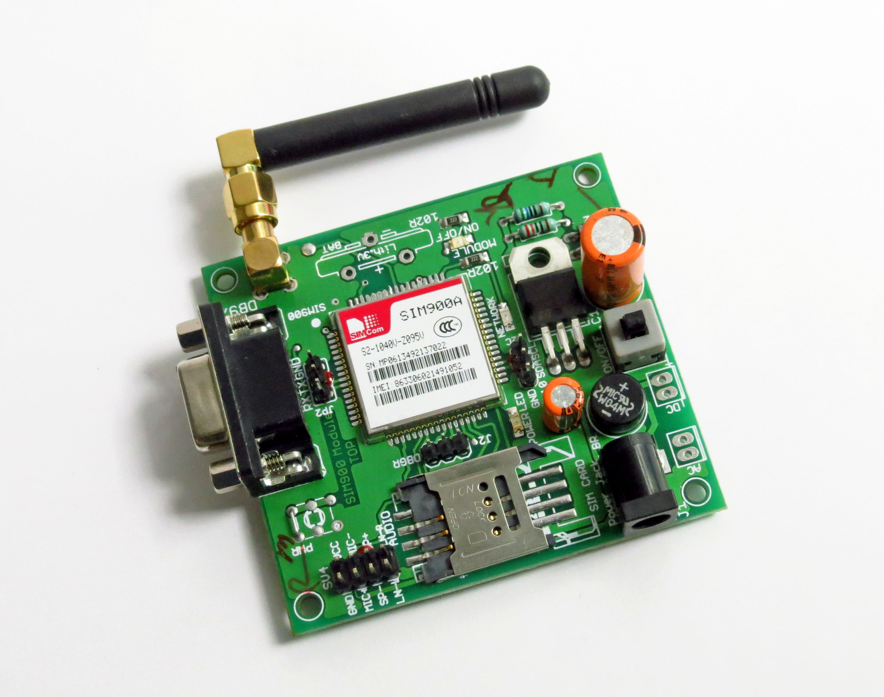
Platform used
ARDUINO MEGA
RFID MODULE
GSM MODULE
IT’S A MICROPROCESSOR WITH OPEN SOURCE PROGRAMMING
IT ENABLES TO READ / WRITE RFID TAGS TO STORE DATA UPTO 1KB
THIS ENABLES US TO SEND SMS IN MICROPROCESSOR SYSTEMS

Slide 10
E-R DIAGRAM OF THE DATABASE STRUCTURE

Slide 11
THANK YOU!

